Slide 1

DE 529 Education Savings PLAN
2024 q1 Business update
PLANS MANAGEMENT BOARD
June 2024 meeting
Office of State Treasurer – Colleen Davis

Slide 2


De529 PLAN– 2024 q1 Plan Assets
2017 | $681 million
2018 | $624.3 million
2019 | $684.4 million
2020 | $728.0 million
2021 | $747.3 million
2022 | $612.67 million
2023 (12.31) | $651.1 million
2024 (Q1) | $673.5 million
Aged Based Portfolios $440.8 million or 68% of total plan assets Active Age-Based ($294.3 million or 44% of total assets) Blend Age- Based ($23.0 million of 3% of total assets) Index Age-Based ($123.5 million or 18% of total assets)
Static Portfolios /Individual Funds/ and Bank Deposit Portfolio 35% of total plan assets $232.7 million As of 3.31.24
Office of State Treasurer – Colleen Davis
2

Slide 3
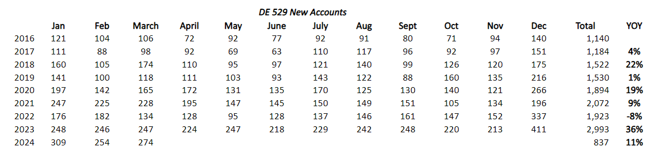
De529 PLAN– New Accounts
New accounts continue to grow year over year by 11% through Q1 (14% through April)
Tailwinds of the stock market performance, seed program, tax incentive and awareness of 529 plans is growing
In Q1 of 2024 we added $17.5 in contributions versus $14.4 in Q1 of 2023
In Q1 of 2024, disbursements were $21.3 million versus $21.9 million in Q1 of 2023
Office of State Treasurer – Colleen Davis
3

Slide 4
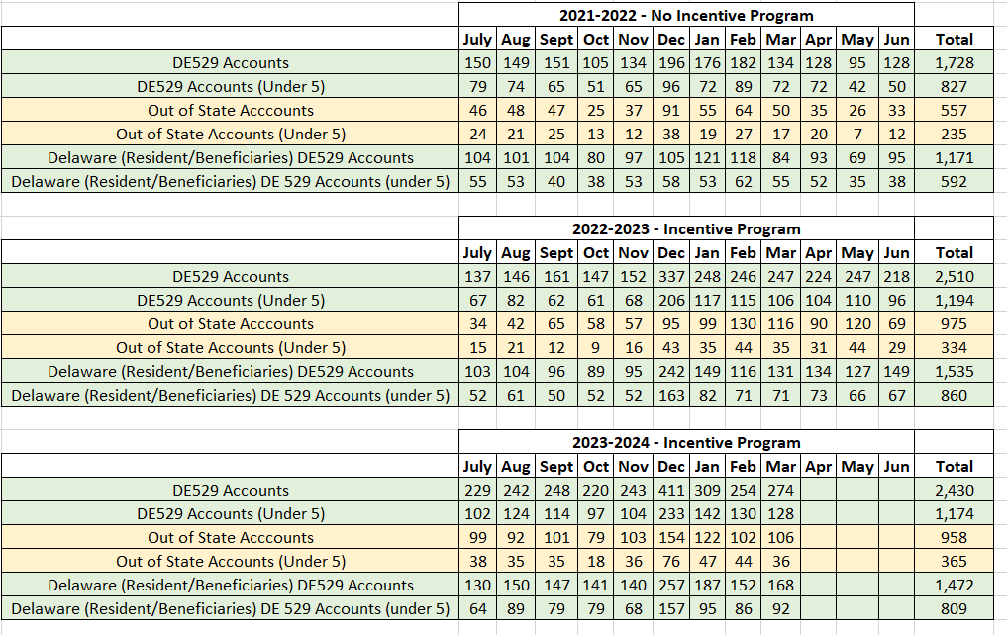
De529 PLANS– First State, First Steps Update
Goal is to grow the plan with new accounts with Delaware families with children under age 5
Office of State Treasurer – Colleen Davis
4

Slide 5
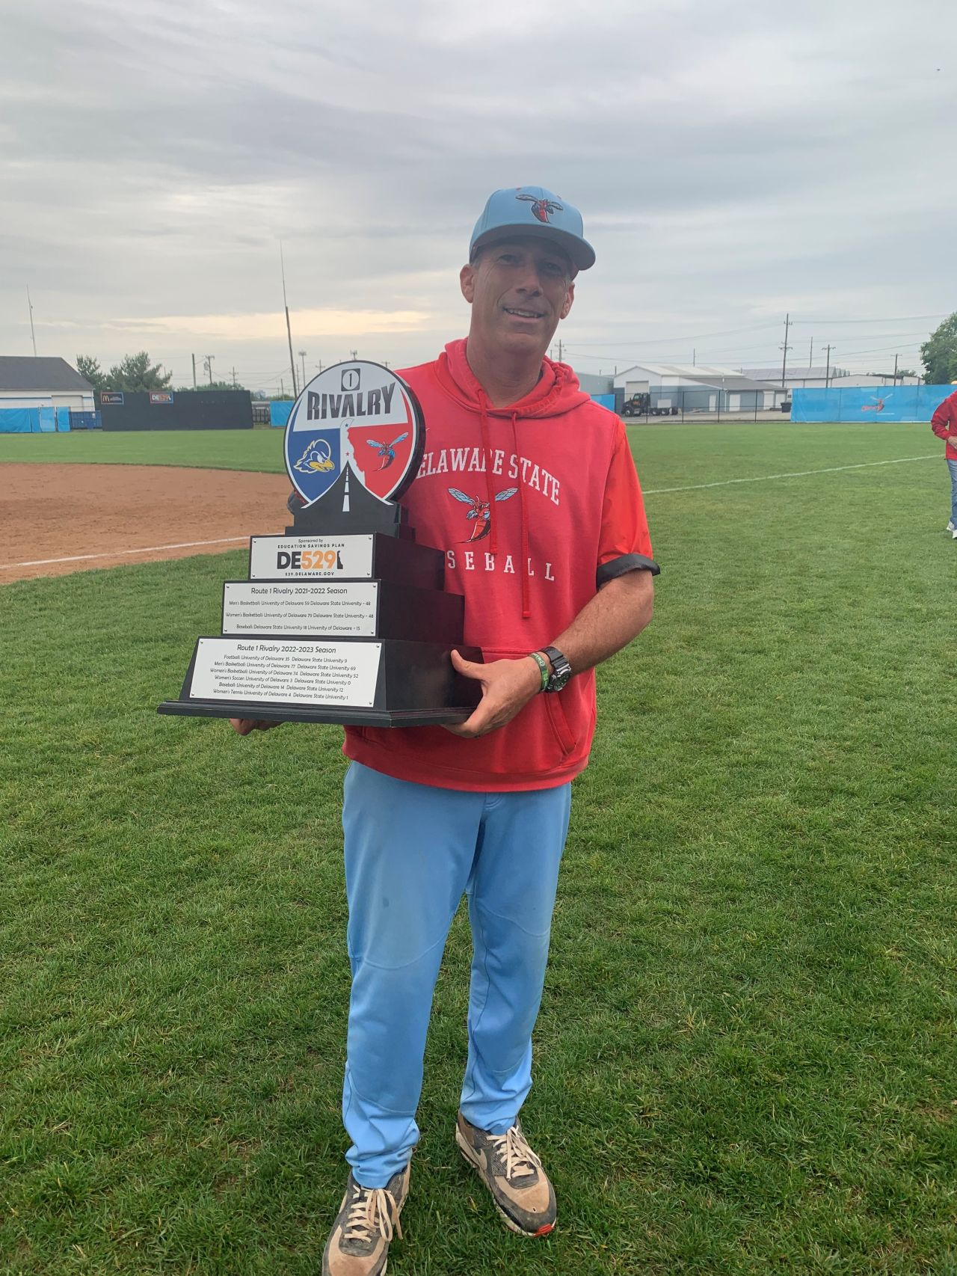
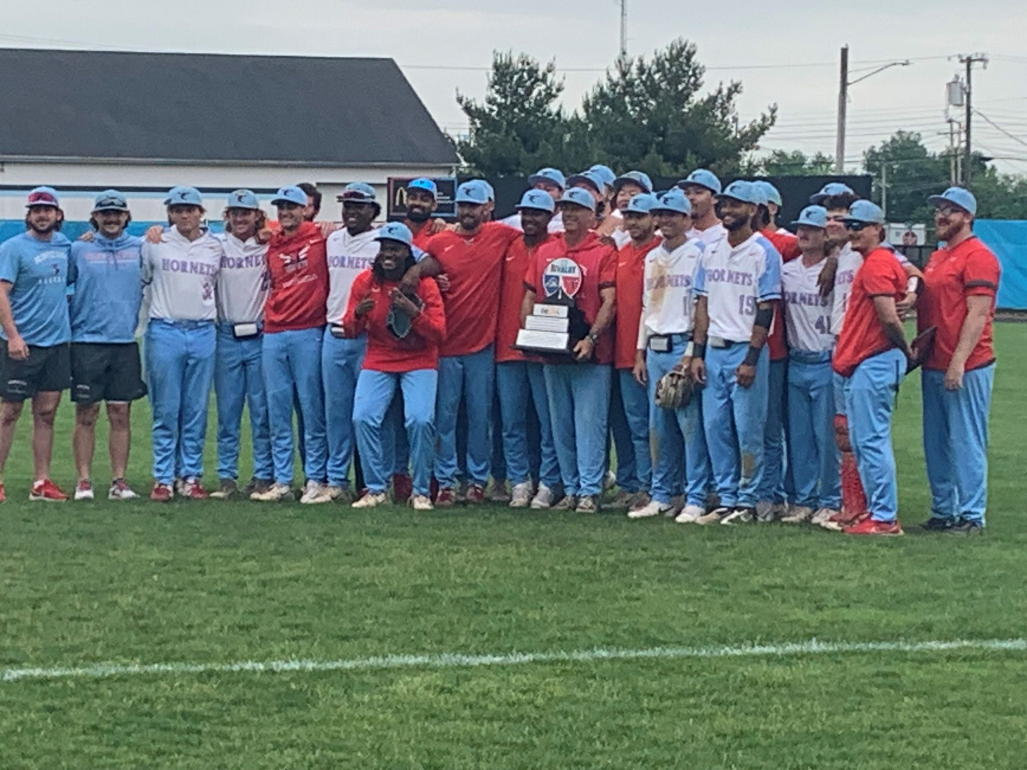
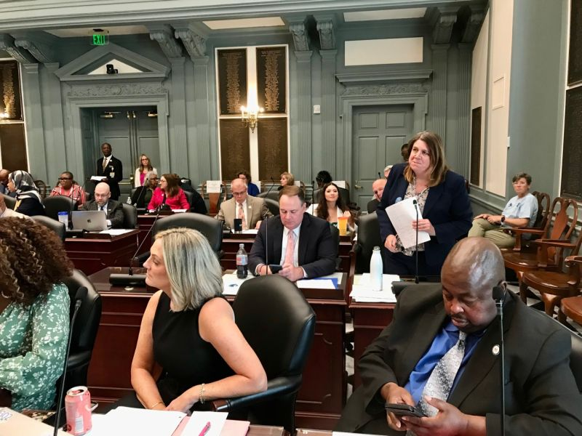

529 PLAN– Promotion and Outreach
Office of State Treasurer – Colleen Davis
5

Slide 6





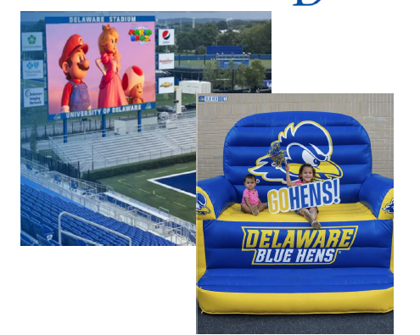
529 PLAN– Promotion and Outreach - Upcoming
Office of State Treasurer – Colleen Davis
6

Slide 7
appendix
Office of State Treasurer – Colleen Davis

Slide 8






529 PLAN– STRATEGIC objectives (Approved by Board September 2021)
Program Summary:
Delaware’s 529 Plan, also known as DE529, is sponsored by the State of Delaware and managed by Fidelity Investments. The Plan provides tax-advantaged accounts designed to help parents, grandparents and others pay for education expenses, reducing the possibility of debt. Contributions can be invested in portfolios tailored to a person’s age or the investor’s ability to identify an asset allocation strategy.
Focus Timeline
2021
RFP for Plan
Rebranding of plan
Grow Accounts
Goal One – Further Optimize Fidelity Marketing and DE529 Plan Marketing Spend
Goal Two – Test and Implement a Match Incentive Program
Goal Three – Establish Partnerships with Top Three Birthing Hospitals in Delaware
Goal Four –Partner with Delaware Public Schools
Goal Five –Workplace Messaging
2022
Test Match Incentive Program (May 29th)
Support HB145 Tax Incentive
Top birthing hospital partnerships
Implement strategy for administrative fee balances
Scholarship Pilot
Increase contributions
2023
Workplace messaging/employer campaigns
Match Incentive Program assessment
Collaborate with Fidelity on workplace
Promotion of gifting tool
Host virtual “State Collective” Summit
Scholarship Pilot
Goal One – Support HB145 Tax incentive legislation within Delaware to attract additional contributions
Goal Two – Test and Implement a Match Incentive Program
Goal Three –Collaborate with Fidelity on Gifting Tool Promotion and Employer Contributions
BUILD TOP TIER plan
2024
Morningstar Medal Assessment
Scholarship Pilot
Goal One – Create a “State Collective” of Fidelity 529 Plans
Goal Two – Continue to Strengthen Oversight with Board and Committees
Goal Three – Implement Strategy for Administrative Fee Balances
Goal Four –Pass HB145 Tax Incentive
Goal Five –Scholarship Pilot (Foster Youth)
Green font represent “always on” efforts
Office of State Treasurer – Colleen Davis
8

