Slide 1

DELAWARE
EARNS
Program Board
Tuesday, November 15, 2022
1:00 p.m.

Slide 2
Agenda
Approve Minutes
Presentations
Action Items
Board Updates
Future Business
Public Comment
Executive Session (None Scheduled)
Adjournment

Slide 3
Welcome and Introductions
Chairwoman Fayetta Blake
Delaware EARNS Program Board Members
Guest Presenters
Members of the Public
Notes:
Acknowledge any notable or VIP guests

Slide 4
Presentations
Best Practices & Lessons Learned for State-Facilitated Auto-IRA Programs
  Angela Antonelli, Georgetown Center for Retirement Initiatives
  Hunter Railey, Colorado Secure Savings
  Michael Parker, OregonSaves
Key Considerations for an Interstate Partnership
  Hunter Railey, Colorado Secure Savings
  Michael Parker, OregonSaves
  Angela Antonelli, Georgetown Center for Retirement Initiatives

Slide 5


State-Facilitated Retirement Savings Programs
An Overview of Program Best Practices and Lessons Learned
Presentation to the Delaware EARNS Board
November 15, 2022
Angela Antonelli
Research Professor and Executive Director
cri.georgetown.edu

Slide 6
Program Management & Oversight
Board
      Develop an efficient decision-making framework and management procedures
      Set governance policies
      Understand fiduciary responsibilities and engage counsel, as needed
      Subcommittees to make program recommendations to full Board
      Assess and plan for budget and/or legislative needs
      Oversee legal and financial reporting requirements
      Enter interagency and interstate agreements
      Conduct an annual review of performance and decision-making process
      Act in a transparent and accountable manner
Important role supporting the Board and staff
Design governance and financial training
If needed, help to explain differences between public and private sector boards
Translate complex recordkeeper and vendor data, especially when putting together RFP for vendors
Help identify critical tasks and timelines and help monitor progress
Support for negotiating key elements of interagency and interstate agreements
Staff
Consultants
Hire program executive with public sector policy and/or relevant administrative experience
Empower the program executive director and other staff and know when to delegate
Program staff support will be needed to handled administrative procedures (e.g., rulemaking), marketing and outreach, data collection, reporting, negotiating terms of interagency or interstate agreements, etc.
Copyright 2022. Georgetown University.

Slide 7
Program Design - Contributions
Keep to the basics in initial program design with additional features to be considered in future years (e.g., lifetime income)
Higher default contribution rates (5%+) work to boost savings
  Almost 75% of OregonSaves workers are contributing at 5%
Auto-escalation of the contribution rate also can durably increase savings
  Some OregonSaves workers are at a 9% contribution level after 4 increases
Maximum default contribution rates between 8 and 10%
Copyright 2022. Georgetown University.

Slide 8
Program Design - Investments
Roth IRA as default savings vehicle while also making traditional IRA an option
  Roth IRA provide greater flexibility to access funds for different needs
Retirement savings programs are not emergency savings programs
Offer fewer investment choices keeping simplicity in mind
  TDF as default with equity, bond, and money market offerings (few actively choose) – at most 3-5 options
  Shift from an asset threshold to a fixed holding period (30-90 days) for initial default contributions provides the liquidity new savers may need as they adjust to entering the program
Copyright 2022. Georgetown University.

Slide 9
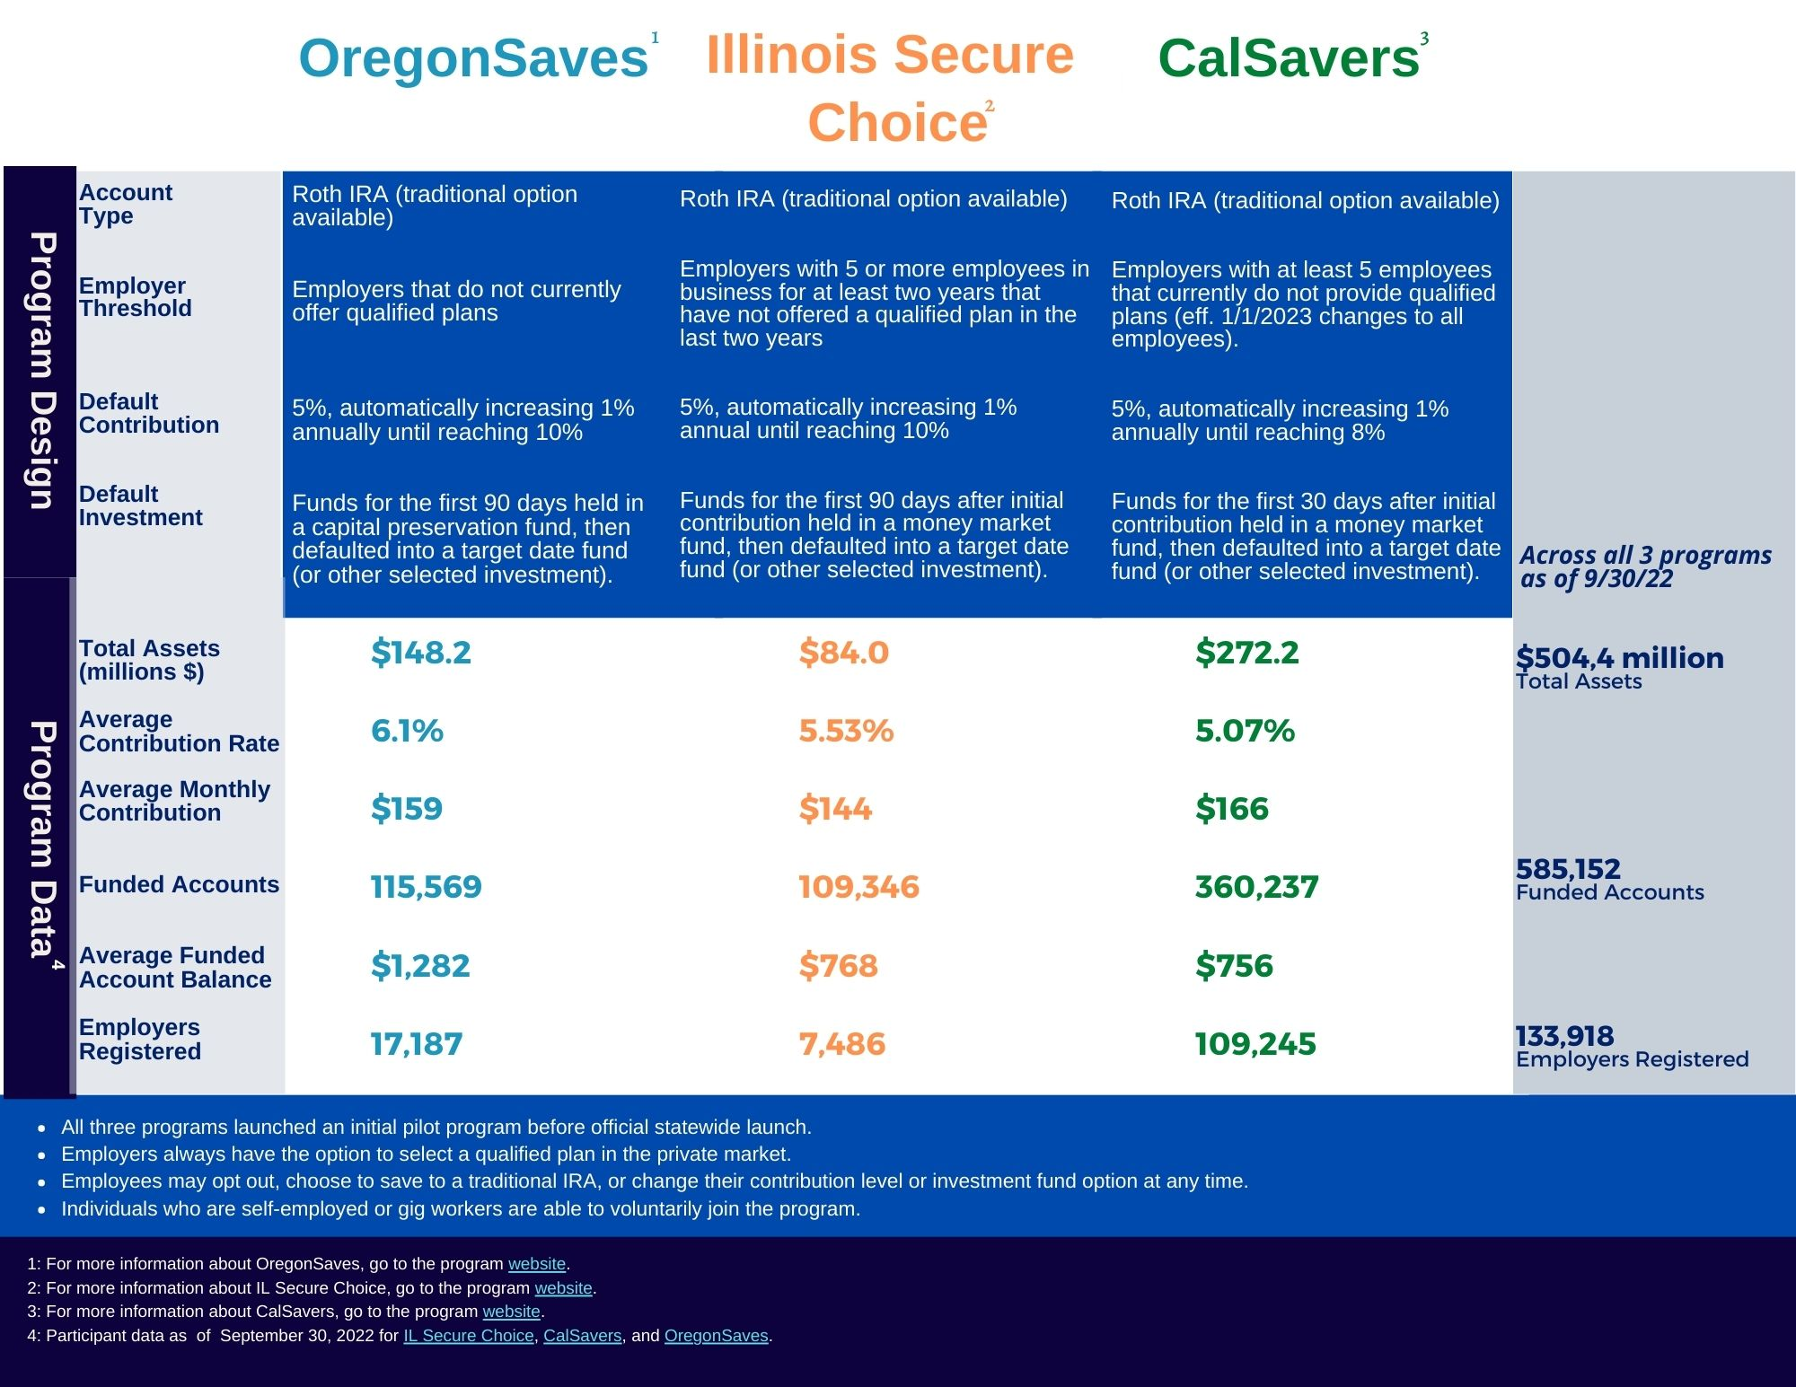
Auto-IRA Programs are increasingly becoming standardized in program design (which better supports inter-state partnerships):
Lower employer thresholds
5% default contribution
Auto-escalation of 1% to a cap
Roth IRA
Short asset holding periods
Simple investment menus
Shorter employer registration timelines
Copyright 2022. Georgetown University.

Slide 10


Program Implementation – Engaging Key Stakeholders
Business &
Employer Associations
Private service providers (Program vendors)
Public & Private sector employer organizations
State Agencies
Advocacy and Other-nonprofit organizations
Employees
Employers
Copyright 2022. Georgetown University.

Slide 11
Program Implementation
Facilitating Employer Participation
Employer Data
  Work with state agencies
  Look for easy existing employer exemption options
  Identify existing sources of state employer data
Marketing and Outreach
  Employer focus generates greatest ROI
  Multi-media outreach
  Multi-lingual approach
Registration Timelines
  Pilot testing is valuable
  Manage onboarding in waves
  Enrollment waves do not need to be long
  All eligible employers can join at any time
  Average of 90-120 days from registration
  to 1st dollar contribution (accelerating now)
Payroll Integration Challenges
  Most employers have their own systems
  Smallest employers can present challenges
  Program administrators are making progress, but challenges remain
  DE EARNS gets a GOLD star
  for its payroll grants initiative
Copyright 2022. Georgetown University.

Slide 12
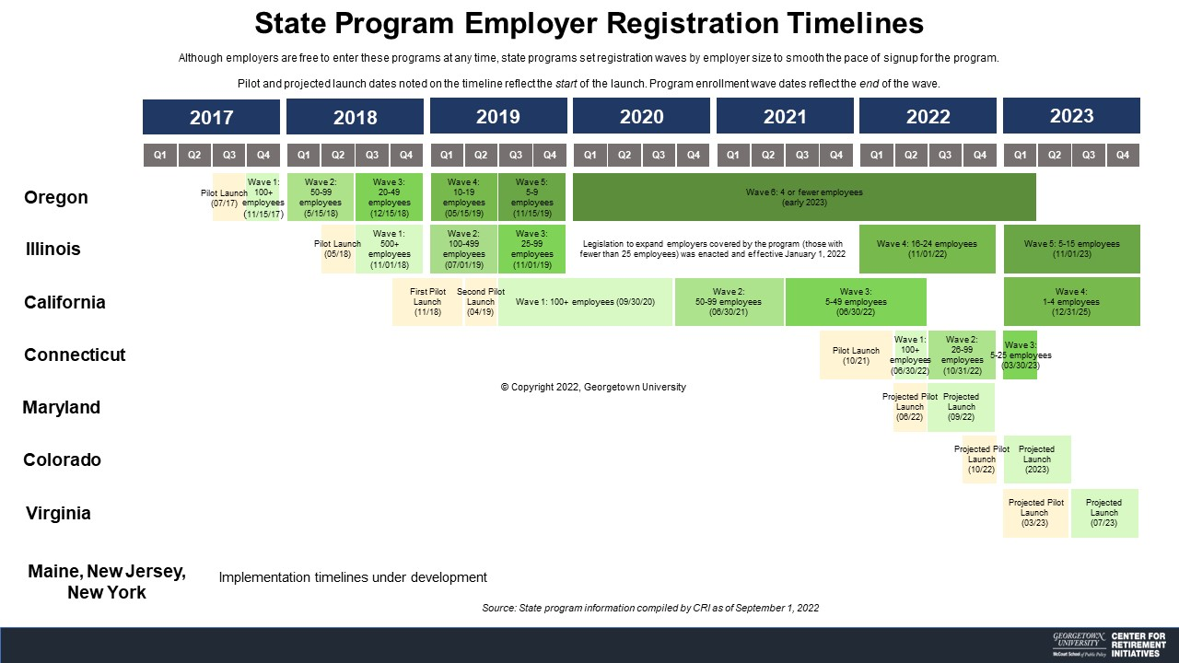
Copyright 2022. Georgetown University.

Slide 13
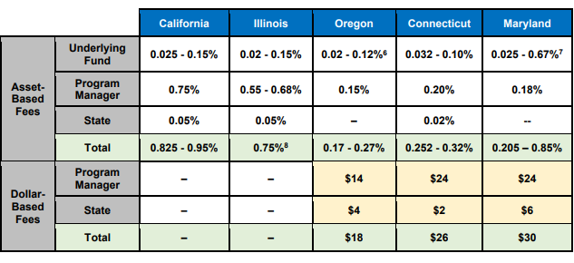
Program Cost Considerations
Early adopters – CA, IL and OR – originally established asset-based fee structures.
Program implementation experience has moved more recent programs in CT and MD to adopt hybrid asset-based and dollar-based fee structures. OregonSaves subsequently updated its fee structure and CalSavers may soon follow.
This hybrid fee structure is not new to the retirement plan market. The addition of dollar-based fees will be important to overall financial strength of the program and program administrators. The move to dollar-based fees will be better for participants in the long-term as assets continue to accrue in these programs.
Achieving economies of scale is critical to long-term success. Thus, for a small state such as Delaware the consideration of partnering with another states is an important consideration.
Source: AKF Consulting Group, with permission.

Slide 14
Program Compliance- Considerations
Consideration of the role of the program and the role of other state agencies in the enforcement process
  Issuance of notices
  Imposition, collection, and use of fines
Soft compliance initiatives as a first step
Every state has different considerations for how to execute
Authority to impose fines in and of itself has an impact
Copyright 2022. Georgetown University.

Slide 15

What Will Be Key to Success?
State Programs are Public – Private Partnerships
Decisions made about:
    Governance
    Staffing
    Design
    Cost Structure
    Ability to Scale
Will determine whether and how many providers will be interested in your program
Copyright 2022. Georgetown University.

Slide 16



cri.georgetown.edu
Angela M. Antonelli
Research Professor
Executive Director, Center for Retirement Initiatives
ama288@georgetown.edu
Follow us on social media for updates:
600 New Jersey Avenue, NW, 3rd Floor | Washington, DC 20001 | 202-306-8540

Slide 17


Partnership Opportunities – Key Considerations

Slide 18
Partnering with Another State
Key Questions
Will partnering with another state strengthen long-term program viability by helping to achieve economies of scale sooner?
How closely does or must our program’s design goals and objectives align with the lead state and other potential partner states?
How much of the program administrative burden and cost can be reduced through an interstate arrangement?
What would be the structure for how key decisions are made?
Where are we willing to accept consistency and where do we need flexibility in program design and administration?
Can we easily exit the agreement should it be necessary?

Slide 19
Colorado’s Partnership for a Dignified Retirement (PDR) Consortium
Interstate Adherence Agreement
The purpose of the PDR is for the States to assist in the ongoing administration of the Program and make Program recommendations (e.g., contribute state representative, participate in meetings, assess and evaluate vendors, and determine shared expenses)
Lead state assumes lead responsibility for drafting RFP for program vendors (evaluated by a committee of states) and executing Master Services Agreement (MSA) with vendors on behalf of the consortium
Partner state has responsibilities for active participation in the consortium
Member states vote on the following:
  Designation of lead state
  Amendments or modification to MSA or the Interstate Agreement
  Removal of a state
  Vendors pursuant to cost-sharing agreement among states
  Determination of whether a state is in compliance with the Agreement and/or its obligations
Member states will discuss, advise, and recommend substantive changes to Programs and/or structure of the Partnership

Slide 20
Colorado’s Partnership for a Dignified Retirement Consortium
Interstate Adherence Agreement
Multi-state consortium operating a private sector mandatory, auto-enrollment payroll deduction IRA Program
States may collaborate, share resources and expertise, and efficiently retain, evaluate and monitor vendors that operate the Program through contracts authorized and executed in accordance with the terms of the Agreement
Lead state can change but it has responsibility for executing a Master Services Agreement with vendors (e.g., program administrator and investment managers)
Partner states sign Partner State Agreements with program vendors that incorporate the Master Services Agreement between the lead state and program vendors

Slide 21
Colorado Partnering with Another State
Individual State Responsibilities Remain
Even if a state enters a partnership there are still basic responsibilities and duties that remain:
Governance and oversight
Staffing
Marketing and outreach (although the nature of the interstate agreement and cost sharing could reduce this, if desired)
Enforcement of employer participation requirement
State reporting, public disclosure, auditing & and other requirements

Slide 22
Contact Information
Michael Parker, Executive Director
Oregon Treasury Savings Network
michael.parker@ost.state.or.us
503-373-1903
Hunter Railey, Executive Director
Colorado SecureSavings Program
william.railey@state.co.us
303-507-5292

Slide 23
ACTION ITEMS
& FUTURE BUSINESS

Slide 24


Next Steps
Next Steps
Votes
  Appoint Committee Chairs
Updates
  RFP for Program Consultant
  Executive Director Recruitment
  Next Board Meeting Date
  Standing Board Meetings
Future Business
  Committee Chairs
  Committee Charters/Resolutions
EARNS
DELAWARE EARNS

Slide 25
Public Comment

Slide 26
Adjournment

Slide 27
For More Information on Delaware EARNS and to Sign-up for Updates…
On the Web: treasurer.delaware.gov/earns treasurer.delaware.gov/earns_board
Email:
Matthew.Rosen@delaware.gov

