Slide 1
*New* BAN/Bond Application Intake Process
Office of the State Treasurer Debt Management Workshop
Friday, February 2, 2024
1:30 pm - 2:30 pm

Slide 2

AGENDA
Welcome to School Finance Directors & Office of Management and Budget Team Members
Introductions – Office of the State Treasurer Staff & Office of Management and Budget Team Members
Overview
Bond Sale Timeline – FY24
Review BAN/Bond FAQs
Review BAN/Bond Application Instructions
Back Office & Reporting Procedures
Questions
Office of the State Treasurer Debt Management Workshop

Slide 3
Introductory Overview
The Office of the State Treasurer is pleased to announce that for the FY24 bond sale, the Debt Management Team has rolled out a new application intake process. This digitized process is in alignment with Executive Order #4 and expects to increase efficiency and effectiveness across State government, streamline communications, improve the metrics used in resource allocation decisions and establish/develop continuous improvement practices that replace previous processes, which were manually intensive, time consuming and more easily prone to data entry error.
Office of the State Treasurer Debt Management Workshop

Slide 4
Workshop Purpose
The purpose of this workshop is to review and walk-through the new, digitized application intake process with our process partners at the school districts, Department of Finance, and Office of Management and Budget to ensure that the transition is as seamless, transparent, efficient, effective and as timely as possible, in coordination with the FY24 bond sale and FY24 year-end closing dates, and within the context of existing resources.
Our discussion will also include a review of the Frequently Asked Questions and Instructions available on the Office of the Treasurer’s website. We look forward to your feedback and comments to continue to improve this process.
Office of the State Treasurer Debt Management Workshop

Slide 5
Review of Timeline – FY24 Bond Sale and
Beyond
Capital Improvement/Bond Bill Signed 06/30/PFY -> Q4 PFY
Debt Management FYE AFCR/Bond Bill 07/01 – 09/30 Q1 CFY
Review and Budget Work
BAN Application Intake 10/04/23 10/04/23 – 11/03/23 Q2 (Extended 02/09/24)
Bond Application Intake 11/11/23 11/22/23 - 12/13/23 Q2 (Extended 02/23/24)
Workiva Tech Implementation 01/2024 - 04/2024 Q3 (Estimated)
Bond Sale Closing 05/2024 (Placeholder) Q4
FY24 Fiscal Year End 06/30/2024 Q4
DBC Debt Manager Tech Implementation 10/2024 (Estimated) Q4
ServiceNow Enhancement – General Inquiries TBD

Slide 6
Frequently Asked Questions
1. How often does the State issue bonds to finance capital projects?
Annually, dependent upon capital project financing requirements. The State’s annual bond process is coordinated by the Department of Finance (DOF), the Office of Management and Budget (OMB) and the Office of the State Treasurer (OST).
2. Is my school district required to complete a BAN or a Bond application?
To get local share funding authorized in the annual Bond Bill, you will need to submit a BAN application (if you require funding prior to the State’s bond sale), or a Bond application.
Office of the State Treasurer Debt Management Workshop

Slide 7
Frequently Asked Questions
3. Do I have to pay interest on the BAN and Bond?
Yes. Interest on school district bonds is set in accordance with Section 7506 of Title 29 of the Delaware code, which specifies "interest at a rate not less than the rate payable on bonds of the
State issued to provide such local share plus an amount to cover administrative expenses of the State in connection with the financing of school construction programs in an amount not exceeding one quarter of 1 percent per annum”. These rates are set forth in the Resolution Establishing Rates, which is a document signed by the State’s issuing officers, authorizing issuance of the General Obligation Bonds.
Interest is also charged on funds advanced, in anticipation of the bond sale, via the BAN instrument. By practice OST has set the interest rate on the BANs based upon the school district bond rate, as reflected in the prior year’s Resolution Establishing Interest Rates.
4. How does my school district apply for capital funding?
During the first quarter of the new fiscal year, the Office of the State Treasurer will notify districts of the application intake period for BAN or Bond applications to receive funds authorized in the State’s Bond Bill. School districts or technical schools that wish to apply will complete an application via the Service Now platform. Applications and processed on a first come-first served basis and BAN applications are prioritized over Bond applications.
Office of the State Treasurer Debt Management Workshop

Slide 8
Frequently Asked Questions
5. What supporting documents are required to submit the BAN/Bond application in Service Now for processing?
The eleven required documents are listed below. For schools which aren’t required to hold referenda, numbers 5 through 11 do not have to be completed.
1. Copy of the minutes, or relevant portions of the minutes, from the Board of Education meeting at which the Board authorized the issuance of the bond/note
2. Dated, fully executed copy of the proposed instrument
3. Copy of the Certificate of Necessity covering the project(s)
4. List reflecting the project(s) to be funded with the proceeds of the bond/note and the local share amount(s) for such project(s)
Office of the State Treasurer Debt Management Workshop

Slide 9
Frequently Asked Questions
Continued…What supporting documents are required to submit the BAN/Bond application in Service Now for processing?
5. Copy of the minutes, or relevant portions of the minutes, from the Board of Education meeting at which the Board approved a resolution calling for a special election to authorize the sale of bonds to fund the project(s)
6. Notice of referendum
7. Documentation from the Department of Elections confirming that the notice (a) contained the information required by 14 Del. C. § 1074(b), and (b) was posted on the Department of Elections' website at least 21 days prior to the date of the referendum
8. Affidavit of publication showing that the notice was published in the manner prescribed by § 1074(b)
Office of the State Treasurer Debt Management Workshop

Slide 10
Frequently Asked Questions
Continued…What supporting documents are required to submit the BAN/Bond application in Service Now for processing?
9. Copy of the ballot used in the special election
10. Copy of the election results issued by the Department of Election under 14 Del. C. § 1083(d)(2)
11. Affidavit of publication or other documentation establishing that, as required by 14 Del. C. § 2123(b), the Department of Elections publicly declared the election results within 10 days of the certification of the results of the referendum
6. Do I have to complete an application if my school district’s project is 100% State funded?
No. Funding is loaded by the Office of Management and Budget. Please contact your assigned OMB Budget Analyst for assistance.
Office of the State Treasurer Debt Management Workshop

Slide 11
Frequently Asked Questions
7. Is a BAN/Bond application required to receive funding for the school district’s project market pressure expenditures?
Yes. School districts will follow the existing process required to receive capital funding for capital improvement projects – please refer to Frequently Asked Question #2.
8. Does my school district have to apply for the entire local share amount authorized in the bond bill?
Yes. A BAN or Bond application received for less than the State and local share amounts authorized in the bond bill (partial) will not be accepted.
Office of the State Treasurer Debt Management Workshop

Slide 12
Frequently Asked Questions
9. What if my school doesn’t hold referenda for capital projects?
If a referendum is not required for you school district to raise monies for capital projects, please use the date 01/01/1900 for the referendum date.
10. Is there a deadline to submit my BAN/Bond application?
Yes. Applications must be received by December 1st unless otherwise specified by the Office of the State Treasurer.
11. How can I get debt service reports for my school district or organization?
A request can be submitted via Service Now to request reports from the OST at http://de.gov/DebtMgmt. Requests will be prioritized in the order received.
Customer Service Survey
Customer service surveys help us make your experience better. Please complete our Customer Service Survey. https://www.surveymonkey.com/r/9Q852Y8
Office of the State Treasurer Debt Management Workshop

Slide 13
INSTRUCTIONS BAN/Bond Application Intake
Office of the State Treasurer Debt Management Workshop

Slide 14
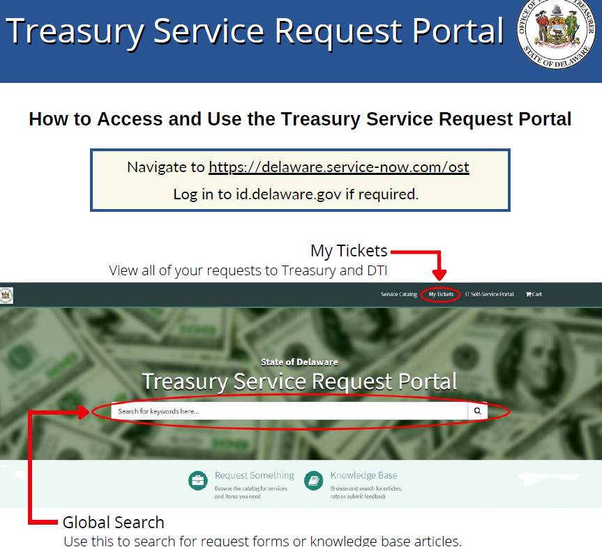
Instructions – Service Now & Adobe

Slide 15
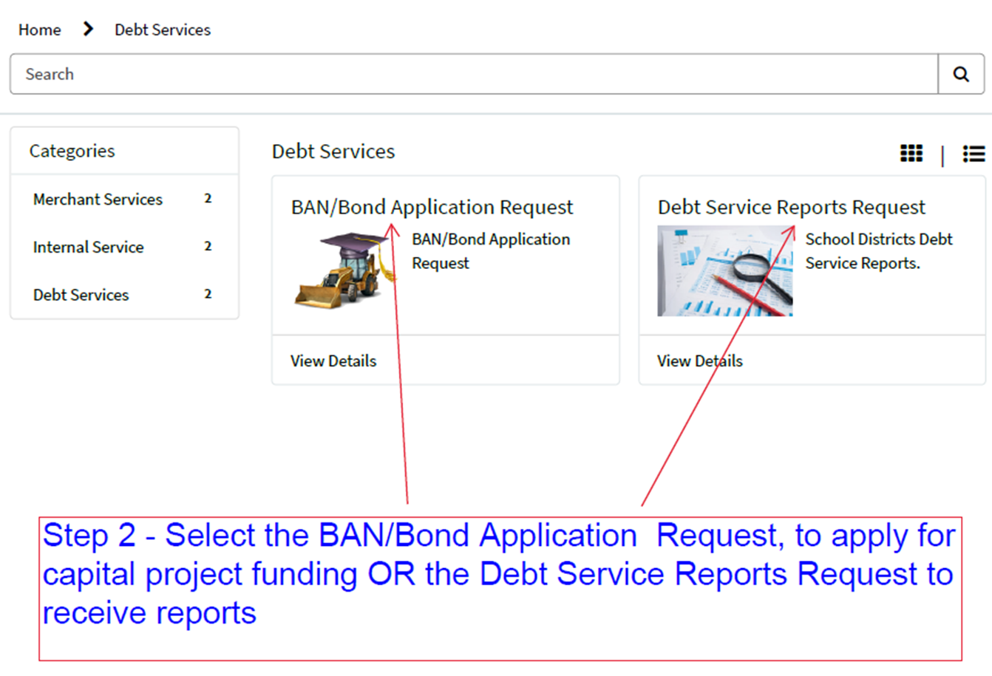
Instructions – Service Now & Adobe

Slide 16
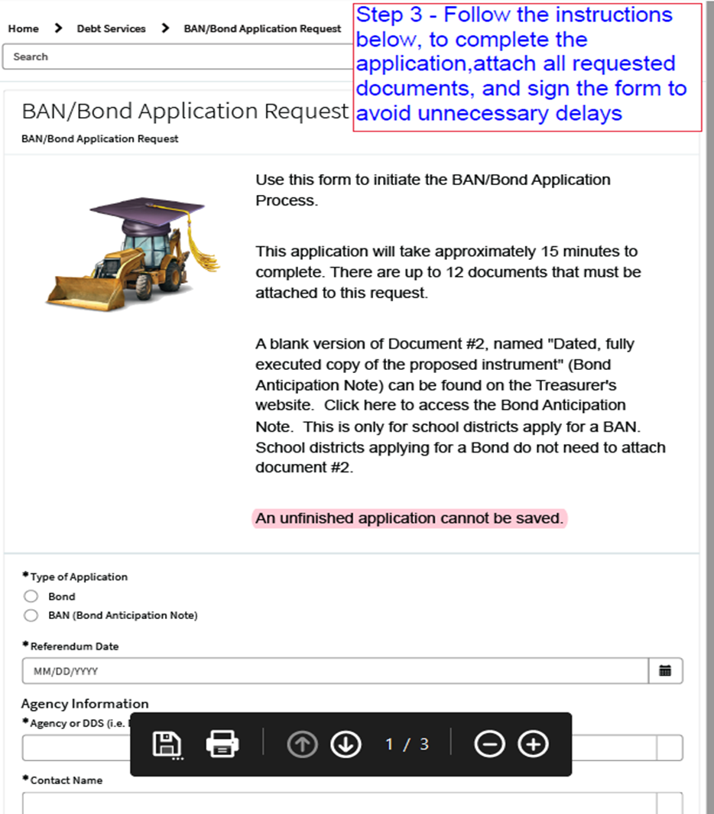
Instructions – Service Now & Adobe

Slide 17
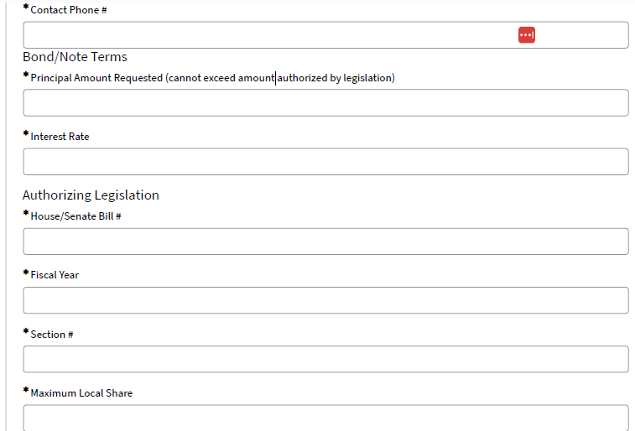
Instructions – Service Now & Adobe

Slide 18
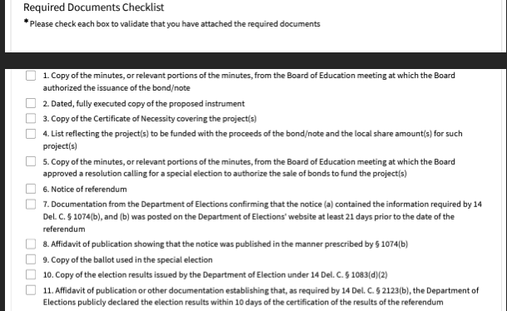
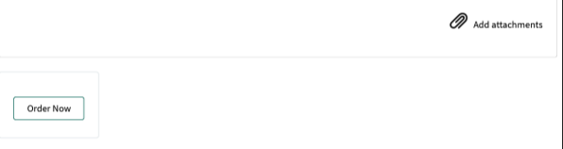
Instructions – Service Now & Adobe

Slide 19
Instructions – Service Now & Adobe
After completion of fields 1-11 of the online BAN/Bond application, by the school district (SD) the form will be submitted to OST via Service Now. Please ensure that all requested and applicable documentation, including the Bond Anticipation Note is attached in ServiceNow. Your application cannot be processed without these documents
The Debt Management Team will review the information for basic accuracy and copy and paste information to the AdobeSign BAN/Bond application document.
The completed AdobeSign BAN/Bond application will be sent to the SD for verification and electronic signature.
Upon receipt of the electronically signed AdobeSign BAN/Bond application, the application will be moved to: (1) OST’s Deputy Attorney Journal (DAG) for signature, (2) OST’s Finance Director, (3) budget journal will be completed and forwarded to OMB to load funding to the FSF appropriation, (4) OST will notify the SD when funding is available for expense processing.
After the bond sale closes, OST will send the bond certificate to the SD for signature.

Slide 20
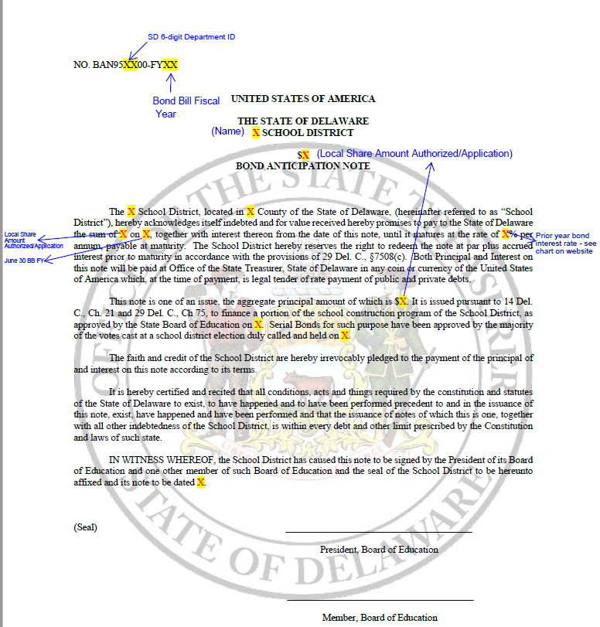
Instructions – Service Now & Adobe – Bond Anticipation Note (BAN)

Slide 21
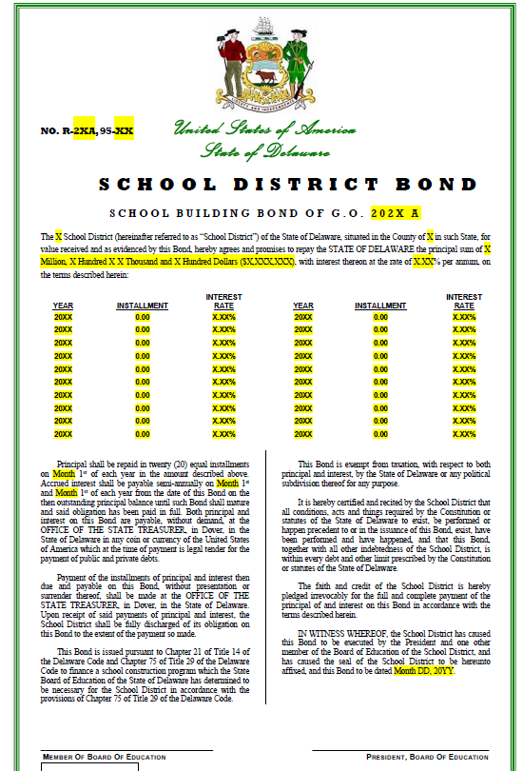
Instructions – Service Now & Adobe – Bond Anticipation Note (BAN)

Slide 22
Back Office Procedures & Reporting
Office of the State Treasurer Debt Management Workshop

Slide 23
Back Office Procedures – Application Processing
The Debt Management Team prepares the budget journal, to load State and Local share of capital funding, authorized in the Bond Bill, and requested in the BAN/Bond application to the designated appropriation. The budget journal is approved by OST’s Finance Director. Upon approval, the budget journal is submitted to OMB for processing.
OMB reviews and approves the budget journal, loads funding to the designated appropriation and notifies the Debt Management Team at OST.
The Debt Management Team verifies that funds are loaded to the designated appropriation and notifies the SD that funding is available for capital expenditures.

Slide 24
Back Office Procedures – BAN Interest & Debt Service
BAN Interest
After the bond sale closing, the Debt Management Team prepares
a General Ledger Journal to charge interest expense to the debt service appropriation of SDs that submitted a BAN application. The interest rate used is the prior year’s Local share bond interest rate.
Debt Service
The Debt Management team prepares a General Ledger Journals for each month in which there is a debt service payment due, to charge principal and interest expense to the SD’s debt service appropriation.

Slide 25
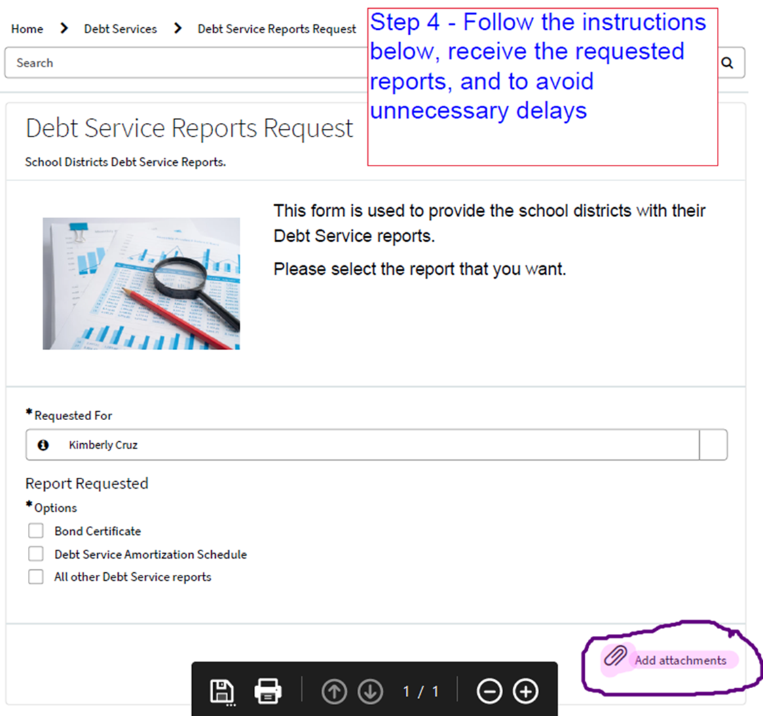
Back Office Procedures – Reporting
Currently, data from the bond sale is used to create amortization tables in Excel, which are then loaded into an Access database to generate debt service reports for the SDs. These reports can be requested using ServiceNow.

Slide 26
Questions from the School Finance Directors ? 
Office of the State Treasurer Debt Management Workshop

Slide 27
Helpful Tips and Links to Information
https://treasurer.delaware.gov/debt-cash-management/ Managing the State's Debt->FAQs & Survey
https://treasurer.delaware.gov/forms-documents-library/ Debt and Bond Anticipation Notes Forms->Bond Interest Rates
https://treasurer.delaware.gov/wp-content/uploads/sites/55/2017/05/BondAnticipationNoteForm-copy.pdf
Bond Anticipation Note (BAN) Form Copy
https://treasurer.delaware.gov/ban_bond_changes/ Instructions for accessing the BAN/Bond application using the Treasury Service Request Portal/ServiceNow

